Slide 1

Sudoku Game Plan Utilizing Graph Coloring
By:
Ivani Patel

Slide 2
Introduction
Sudoku is a single-player popular number-placement puzzle based on logic and combinatorics.
The objective is to fill a 9 × 9 grid with digits such that each column, each row, and each of the nine 3 × 3 subgrids that compose the grid contain all of the digits from 1 to 9(once and only once).
Usually the puzzle is partially filled in a way that guarantees a unique solution

Slide 3
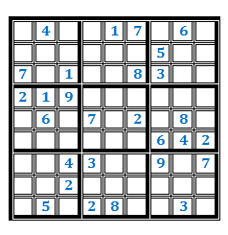
A sample Sudoku puzzle
Each row, column and square (9 spaces each) needs to be filled out with the numbers 1-9, without repeating any numbers within the row, column or square.

Slide 4
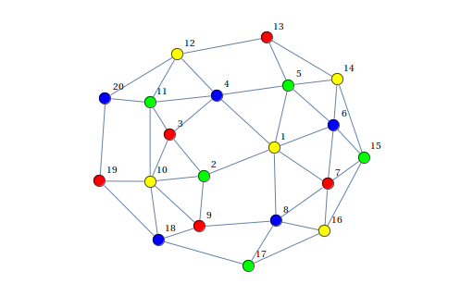
What is Graph Coloring ?
Graph coloring is the procedure of assignment of colors to each vertex of a graph G such that no adjacent vertices get the same color. So, each vertex has a different color from its neighbors.
The objective is to minimize the number of colors used for the coloring of vertices.
In the graph coloring problem, we have to find if a graph can be colored with a minimum of ’G’ colors. Before starting to color the graph, one should know the minimum number of colors required to color the graph.

Slide 5
Solving Sudoku using Graph Coloring
The graph has 81 vertices in the standard sudoku where every vertex is adjacent to 8 vertices in its row + 8 vertices in its column and 4 more leftover cells in its block.
So, the degree of every vertex in the graph is the same. Each vertex has a degree of 20.
The number of edges is:
|H| = 20 ∗ 81 /2
= 810

Slide 6
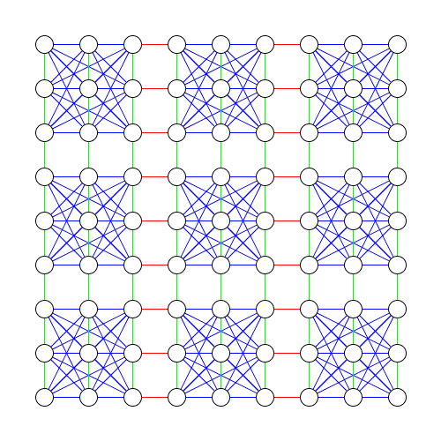
Mathematical Model
Initialize the graph representing the 9 × 9 sudoku where each node represents a box.
Make the connections in the graph. As per the rule of the sudoku, we will connect a specific node to every node in its 9 × 9 sudoku grid, also to all the nodes in its rows and columns.

Slide 7
Examining the figure
The circle represents any digit from 1-9 each.
The green lines associate circles that can’t be a similar digit since they’re in the same column.
The red lines associate circles that can’t be a similar digit since they’re in the same row.
The blue lines associate circles that can’t be a similar digit since they’re in the same 3 x 3 square.
Green and red are the most prominent. Only 4 blue lines from any single circle are visible because the other blue lines are occluded from either green or red since those circles are also in this same row or column in addition to being in the same 3 x 3 square

Slide 8
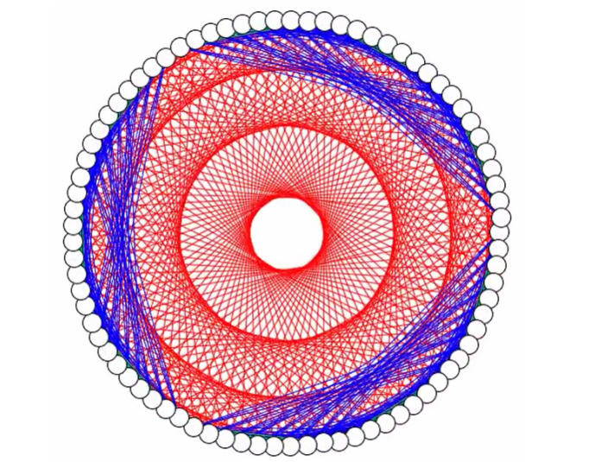
Continue…
We can change it into a more improved image that looks like this.
We can notice the exact connectivity between each node clearly. We can see this issue as a graph in which we have to color such that no adjacent will have the same color. There are 9 distinct elements:1-9 hence we need 9 colors for satisfying this constraint. Consequently, the chromatic number = 9. So now sudoku can be viewed as a Graph.

Slide 9
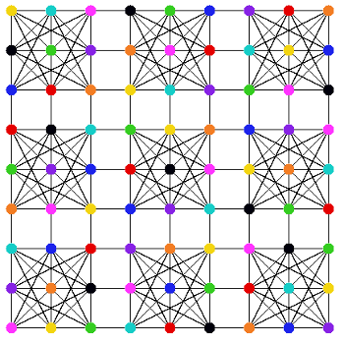
Continue Process
Apply the coloring function to color the nodes of the graph. The coloring function will assign a color to each number from 1 to 9 and then assign the colors to the different nodes.
After giving color to each node such that no two adjacent vertices receive the same color, we get the graph as shown.

Slide 10
Continue
In order to fully ”color” the sudoku with the correct number in each box, we start by finding which node has the most colored neighbors. Whenever we have found this node, we narrow down the possible colors it can be by removing all the colors that its neighbors have. The algorithm inserts one of the possibilities into the graph and repeats the process of finding the next node to fill.
Assuming the color was right, it will continue to add colors until the whole riddle is tackled. On the off chance that for any node its neighbors as of now have 9 various colors, the arrangement is wrong since we realize that the diagram can be colored utilizing precisely 9 colors. For this situation where it ended up speculating an inaccurate solution it will return to that decision point and attempt an alternate color, to check whether it works with that one. This is a common strategy called backtracking, used when you are slowly working towards a solution by making guesses to get closer.

Slide 11
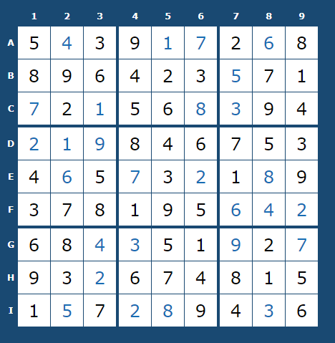
Continue..
Now when all the adjacent nodes have been assigned different colors, convert the colors back to their assigned numbers.
As a result we got solved Sudoku Puzzle. And get results as shown in the figure.

Slide 12
Thank you
Thank you

